Slide 1

MARIA

Slide 2






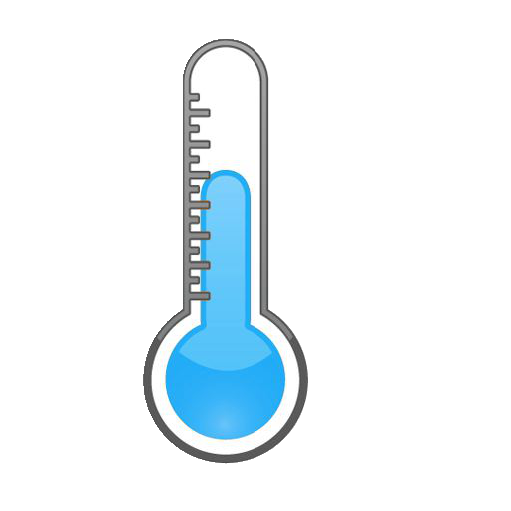
MARIA
BUILDING OPERATOR
We have to save energy!
I’m freezing!
18°C

Slide 3
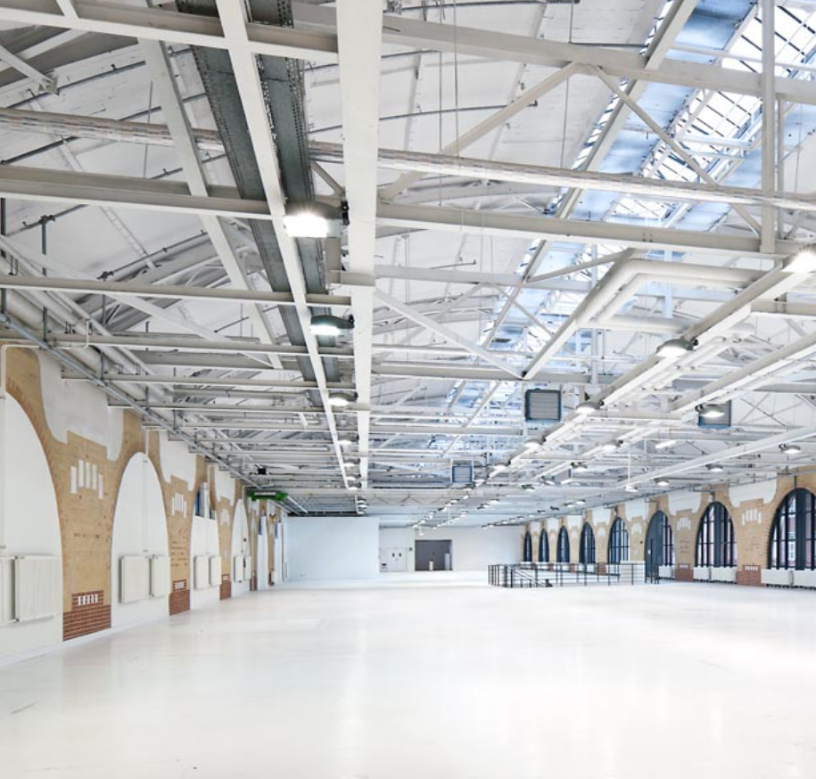

Reduction of the room temperature by 1°C ≈ 6% energy saving
Example:
STATION BERLIN Halle 5
2000 m²
Yearly savings of about
5000 €
5000 kg CO₂

Slide 4





Hue-Heat Hypothesis
Feels good!
+
+
C. A. Bennett and P. Rey, Hum Factors 14, 149 (1972); F. Albers et al., Int. j. light. res. technol. 47, 483 (2015); Y. Tsushima et al., PLoS One, 15, 0236321 (2020); G. Chinazzo et al. Hum Factors 63, 474 (2021).

Slide 5
ChromERGY

Slide 7
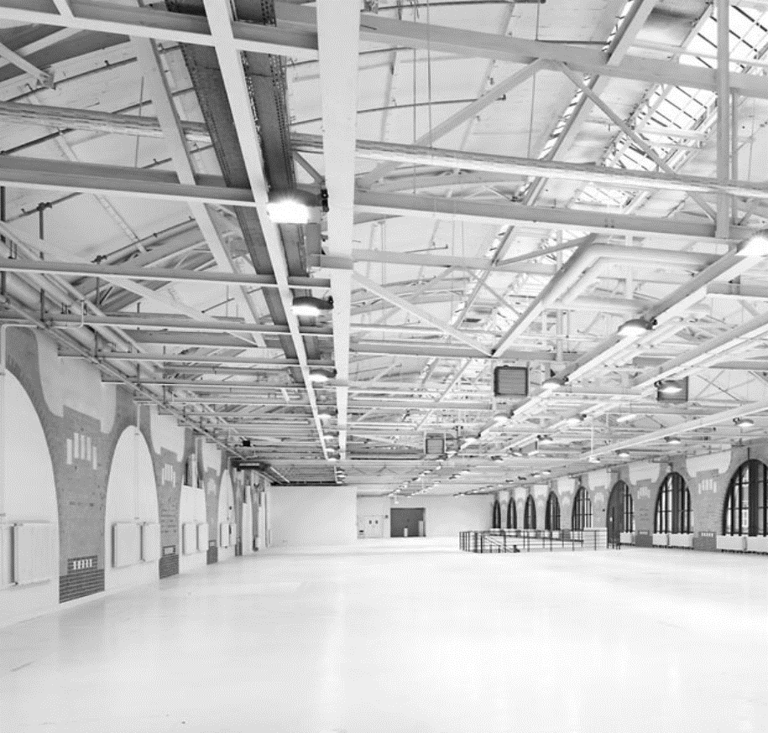
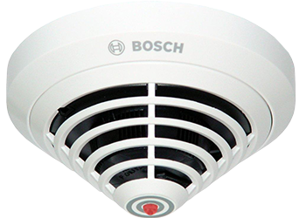
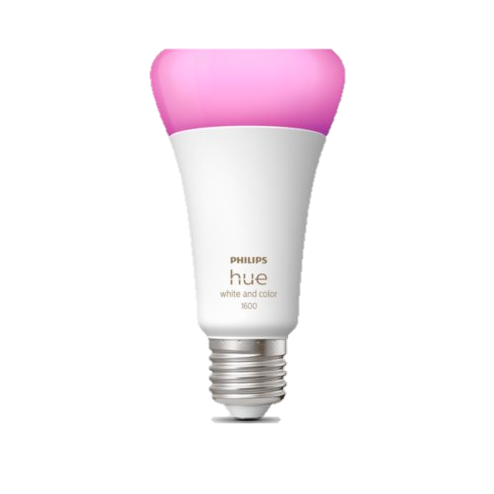




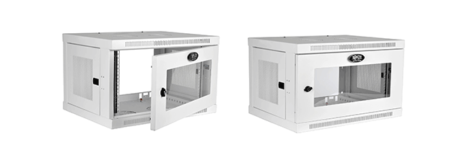

Potential
partners
ChromERGY

Slide 8
Potential
partners
Cost-efficient & simple upgrade
ChromERGY

Slide 9


MARIA
BUILDING OPERATOR
Great
solution!
18°C

